Slide 1

Robustness of Arithmetic LLMs
Under Out-of-Distribution Inputs
The Role of LoRA Rank in Robustness–Efficiency Trade-offs
Yihao Wang

Slide 2
General Introduction
Project track: Arithmetic LLM
Research question:
At what point does the Arithmetic LLM’s reasoning degrade under systematic out-of-distribution inputs?
How does LoRA rank influence robustness–efficiency trade-offs?
Base workflow: foundational training → instruction tuning → LoRA fine-tuning
Motivation: This project aims to evaluate whether arithmetic reasoning in small models is robust under distribution shift and to determine whether parameter-efficient fine-tuning improves generalization.

Slide 3

Method Overview
Training distribution
OOD tests
Synthetic arithmetic expression
max depth = 4
number range 1 - 20
instruction format with step-by-step reasoning
Deeper expressions
max depth = 6
max depth = 8
Larger numbers
range 1 - 50
range 1 - 100
Evaluation metrics
Exact-match accuracy (main metric)
Inference speed
Parse success rate

Slide 4
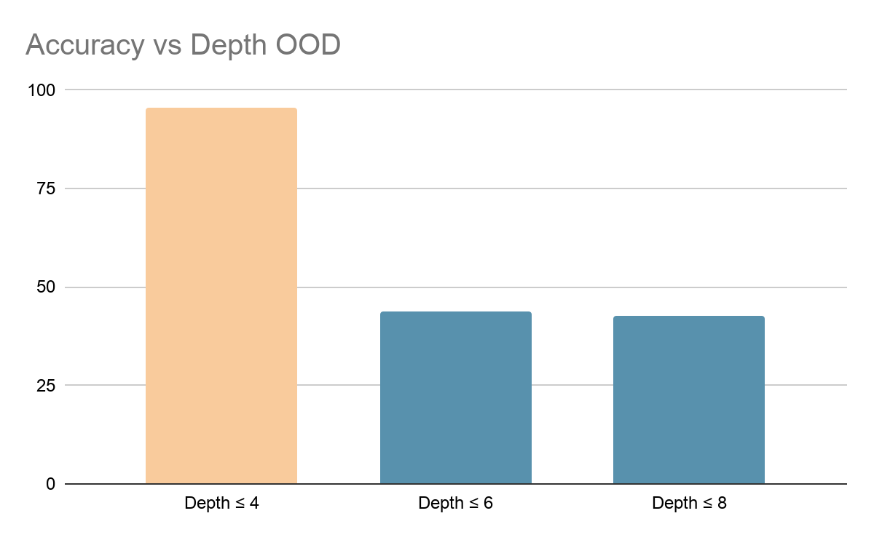
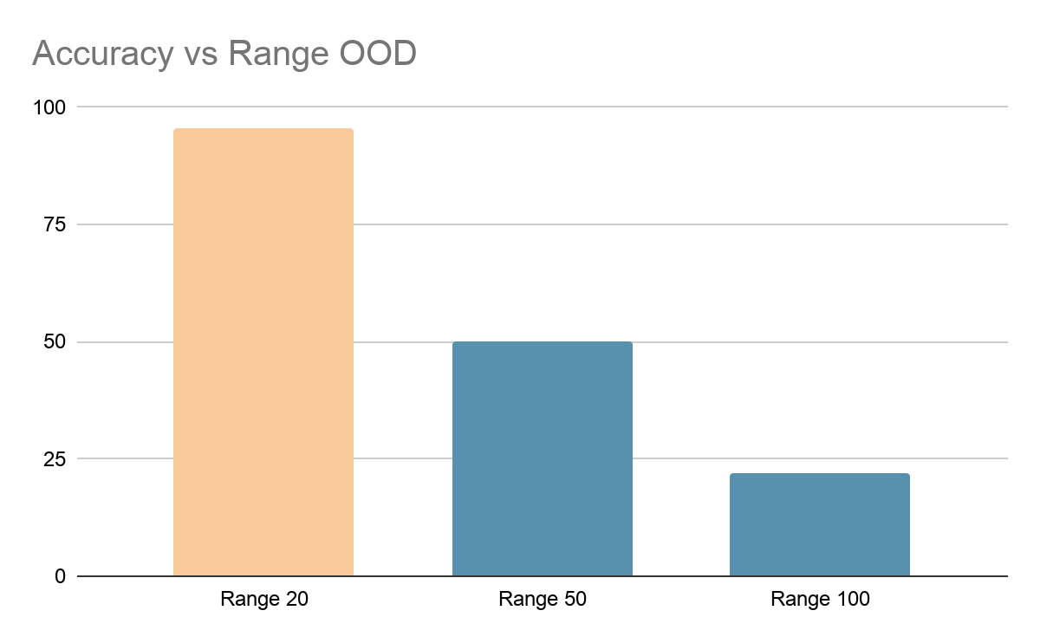
OOD degradation
Takeaway
The model performs well in-distribution, but accuracy drops sharply once we increase expression depth or number range.
This indicates limited generalization of learned reasoning.

Slide 5
OOD degradation
Expression: 0 + (0 + (0 + (0 + (0 + 1))))
Ground Truth: 1
Predicted: 1
Correct: True
Generated Text:
Evaluate : 0 + ( 0 + ( 0 + ( 0 + ( 0 + 1 ) ) ) ) <think> <think> Step 1 : 0 + 1 = 1 Expression now : 0 + ( 0 + ( 0 + 1 ) ) Step 2 : 0 + 1 = 1 Expression now : 0 + ( 0 + 1 ) Step 3 : 0 + 1 = 1 Expression now : 0 + 1 Step 4 : 0 + 1 = 1 Expression now : 1 </think> Final Result : 1
Expression: 0 + (0 + (0 + (0 + (0 + (0 + (0 + 1))))))
Ground Truth: 1
Predicted: -1
Correct: False
Generated Text:
Evaluate : 0 + ( 0 + ( 0 + ( 0 + ( 0 + ( 0 + ( 0 + 1 ) ) ) ) ) ) <think> <think> Step 1 : 0 + 1 = 1 Expression now : 0 + ( 0 + ( 0 + 1 ) ) ) - ( 0 + ( 8 + 11 ) ) Step 2 : 0 + 1 = 1 Expression now : 0 + ( 0 + 1 ) ) - ( 0 + ( 8 + 11 ) ) Step 3 : 0 + 1 = 1 Expression now : 0 - 1 Step 4 : 0 + 1 = 1 Expression now : 0 - 1 Step 5 : 0 - 1 = - 1 Expression now : - 1 </think> Final Result : - 1

Slide 6
OOD degradation
Expression: 15
Ground Truth: 15
Predicted: 15
Correct: True
Generated Text:
Evaluate : 15 <think> <think> </think> Final Result : 15
Expression: 75
Ground Truth: 75
Predicted: 2
Correct: False
Generated Text:
Evaluate : 75 <think> <think> </think> Final Result : 2

Slide 7
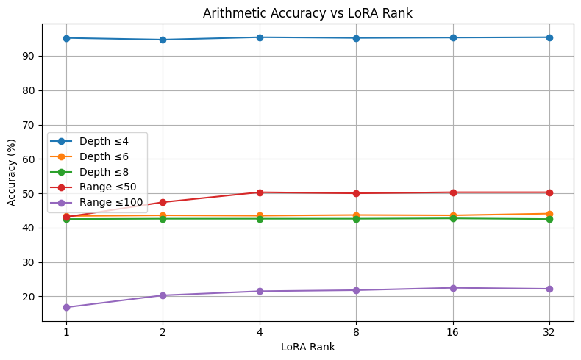
Key results: accuracy vs. LoRA rank
Main observations
ID accuracy (depth ≤ 4) is already ~95% for every rank.
Depth OOD stays around ~43–44% even as rank increases.
Number-range OOD improves with rank, especially from r=1 to r=4.
Very large ranks give little extra benefit over moderate ranks.

Slide 8
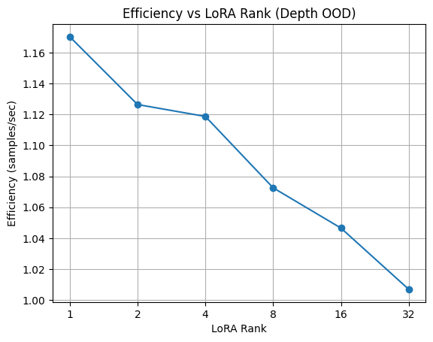
Robustness–Efficiency Tradeoff

Slide 9
Insights & limitations
What worked best?
Low-rank adaptation is enough for in-distribution arithmetic: even rank 1 reaches ~95% accuracy on depth ≤ 4.
Moderate ranks (around 4–16) give the best robustness–efficiency balance for larger numbers.
What surprised me?
Increasing rank barely changes depth-based OOD accuracy.
Depth reasoning looks like the bottleneck, not adapter capacity.
Limitations:
Synthetic data only; no multiplication/division or natural-language arithmetic.
Test sets use max depth, so they still include some easier expressions.
I benchmarked robustness carefully, but speed measurements are newly added and would benefit from repeated runs.

Slide 10
Answer to the Research Question
At what point does the Arithmetic LLM’s reasoning degrade under systematic out-of-distribution inputs?
The Arithmetic LLM’s reasoning degrades sharply when inputs exceed the training distribution.
For structural complexity, performance drops dramatically once expression depth increases beyond 4, falling from ~95% to ~43% at depth 6.
For numerical range, degradation begins at moderate extrapolation (range 50) and becomes severe at larger values (range 100), where accuracy drops to ~20%.
How does LoRA rank influence robustness–efficiency trade-offs?
Increasing rank has almost no effect on depth robustness, but it improves robustness to larger numerical ranges. At the same time, higher ranks reduce inference efficiency. Therefore, larger adapters are not worthwhile for deeper reasoning, but moderate ranks provide a better trade-off when robustness to large numbers matters.

Slide 11
Thank You!

Slide 12
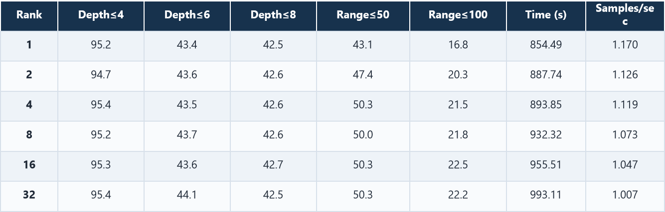
Appendix 1: Supplemented Results Table
Exact-match accuracy (%) by rank and test condition

Slide 13
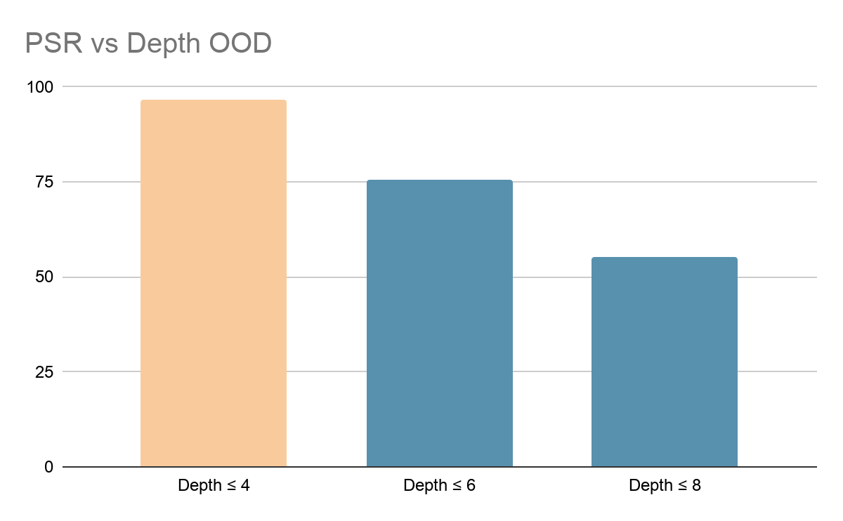
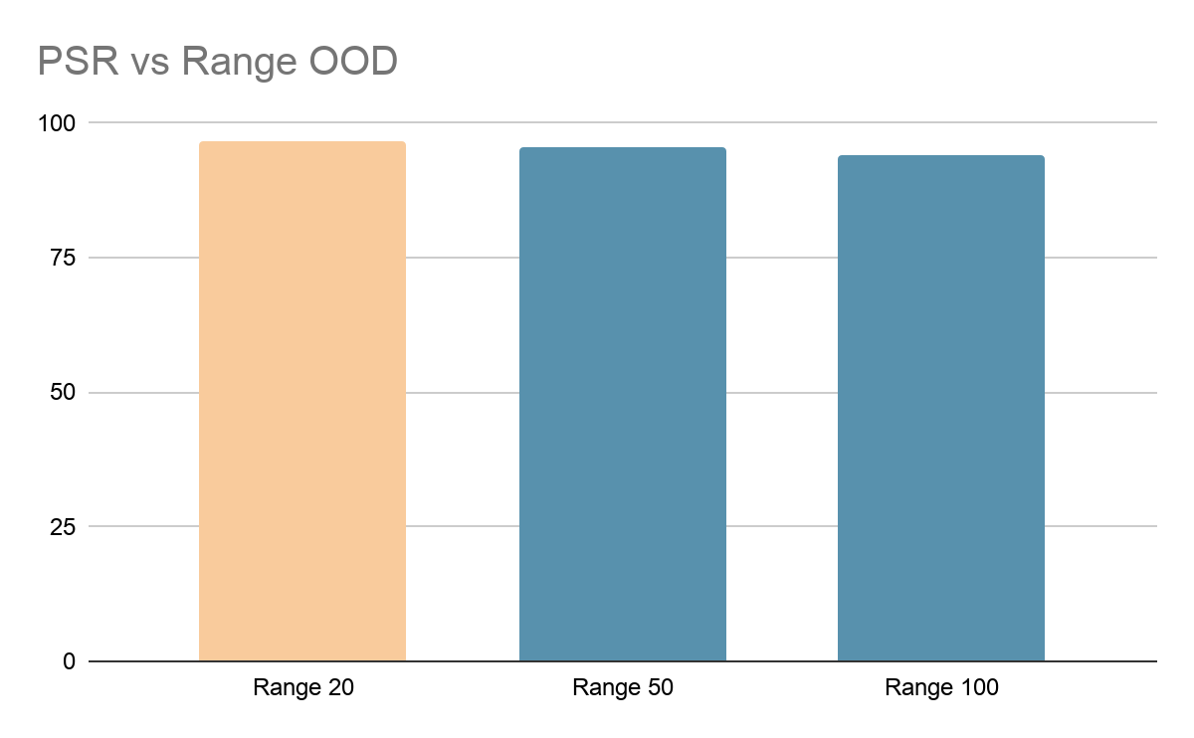
Appendix 2: Parse Success Rate vs. OOD (LoRA Rank = 8)

Slide 14
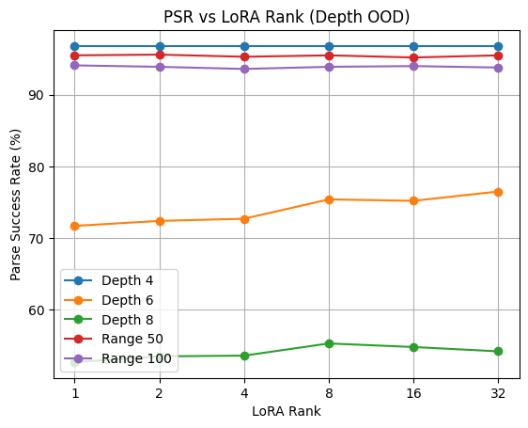
Appendix 3: Parse Success Rate vs. LoRA Rank

